Slide 1
Real-Time Stock Data Messaging System
Final Demo
Leiquan Pan
Jiangnan Liu

Slide 2
Outline
Motivation and background
System Components
System Architecture
Latency Measurements
Summary

Slide 3
Motivation
More and more people invest money in stock
Huge amount of stock data produced every seconds
High demands on receiving real-time stock data
People taking different investing strategies require different information

Slide 4


System Components
Apache Flink
Distributed, High-Performing,Accurate
AWS EMR Cluster
Hadoop Yarn Framework
Computation Load
Real-Time Performance
Apache Flink
Apache Hadoop
Amazon EMR(Cluster)

Slide 5

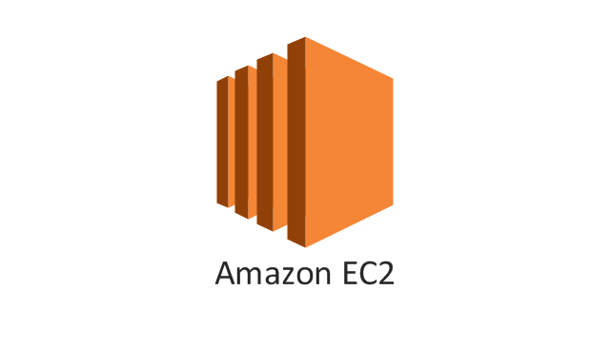
System Components
Why EC2?
Remote server the same as the real world configuration in stock data processing. t2.micro config with 1GiB memory
cheaper comparing to purchase a local server.
Why NSQ?
Open source and easy to deploy on ec2. Written in golang, easy to learn and run in different platforms.
Type system is really important for large scale applications.
Handle better with large concurrency and CPU utilization
NSQ

Slide 6
System Architecture
nsqd1
NSQ Sub0
Stock Data
Classification
(Flink job)
NSQ Pub0
Data Source
(Now: file
Future: stream)
nsqd2
NSQ Sub1
NSQ Pub1
nsqlookupd
NSQ Pub2
NSQ Sub2
NSQ Pub3
nsqd3
NSQ Sub3
nsqd4
Hadoop
Master(Job Manager)
(Amazon EC2)
Slave(Task Manager)
Slave(Task Manager)
(Amazon EC2)
(Amazon EMR)

Slide 7
Implementation of Flink
Based on EMR Cluster
easy to build up, high performance
Apply Hadoop Yarn framework to run Flink
Created a Flink job to process data
Sink processed data to NSQ publisher
Stock Data
Classification
(Flink job)
Hadoop
Master(Job Manager)
Slave(Task Manager)
Slave(Task Manager)

Slide 8
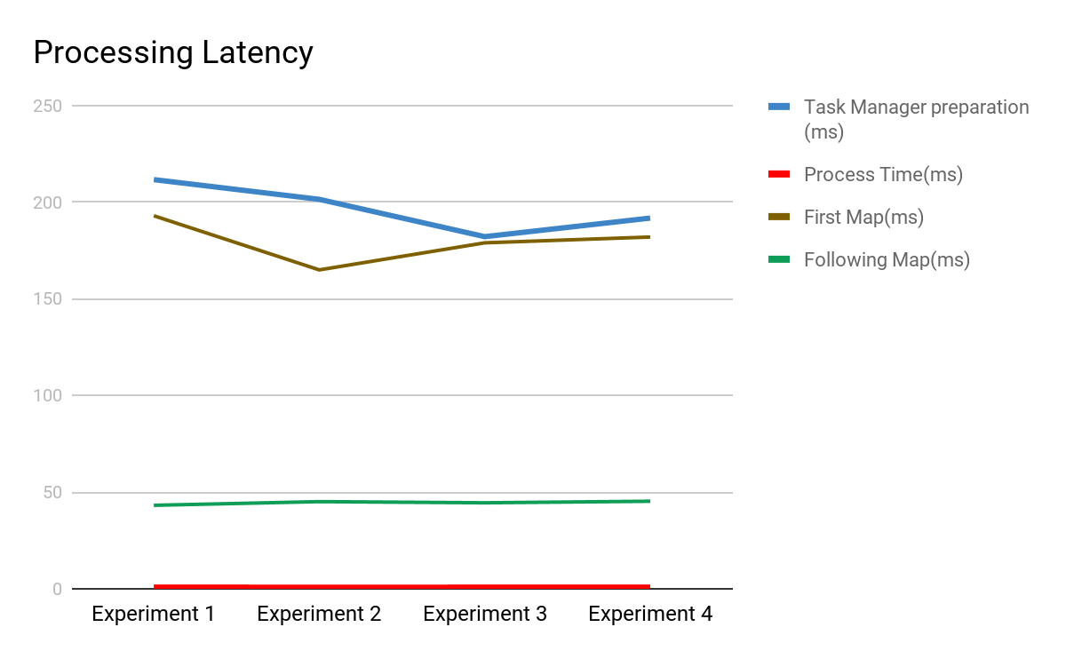
Flink Latency Measurements
Event Time
Constant value avg = 5801.33ms
Processing Time(map function)
Task Manager Initialization
Processing
First Map Function execute longer
Ingestion Time
Sink to NSQ publisher(discussed later)

Slide 9
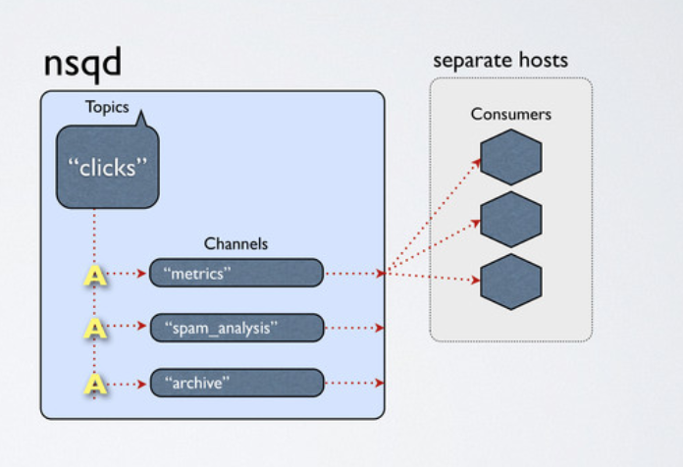
Refresh of NSQ service
a topic is a distinct stream of messages (a single nsqd instance can have multiple topics)
a channel is an independent queue for a topic (a topic can have multiple channels)
consumers discover producers by querying nsqlookupd (a discovery servicefor topics)
topics and channels are created at runtime (just start publishing/subscribing)

Slide 10
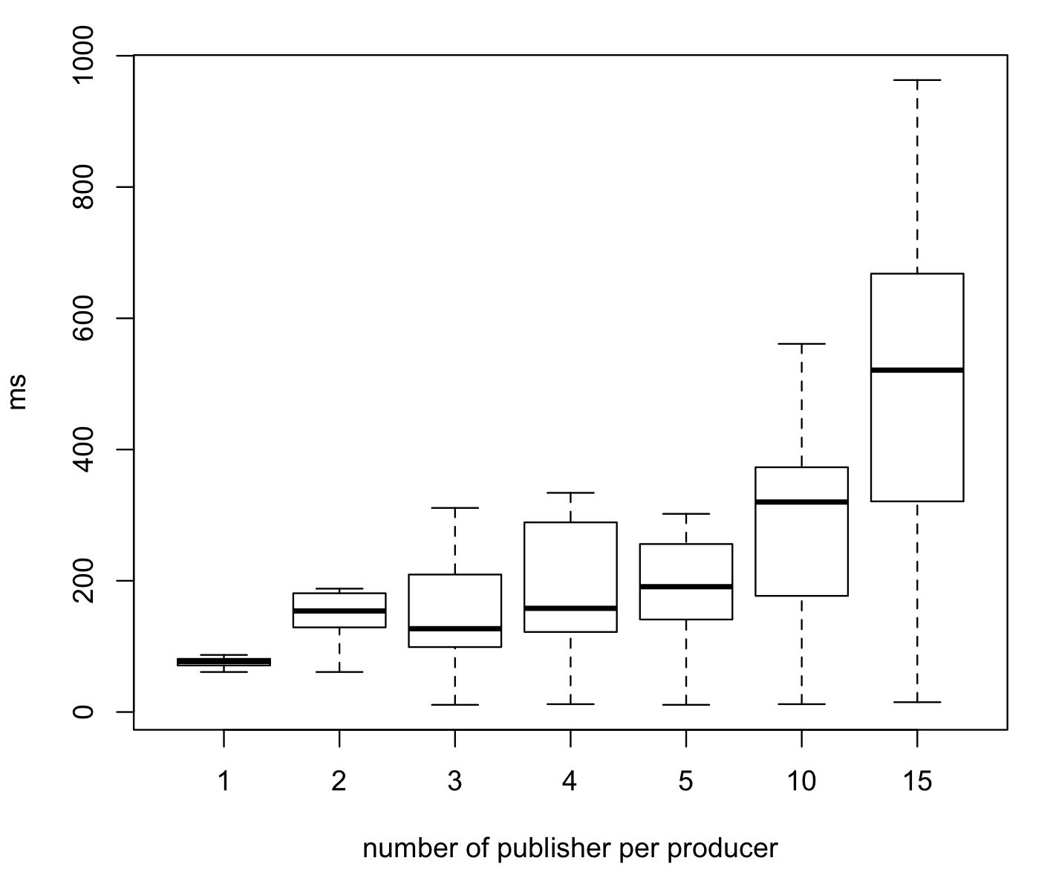
NSQD latency performance evaluation
The more messages, the larger the the latency.
In this experiment, each producer has 3 publishers and generate 1 topic messages to 1 subscriber.
CPU utilization reaches 62% when publishing message 120,000 msgs.
Bottleneck of 250,000 msgs per publisher with 3 publishers.
number of messages per publisher in 1K

Slide 11
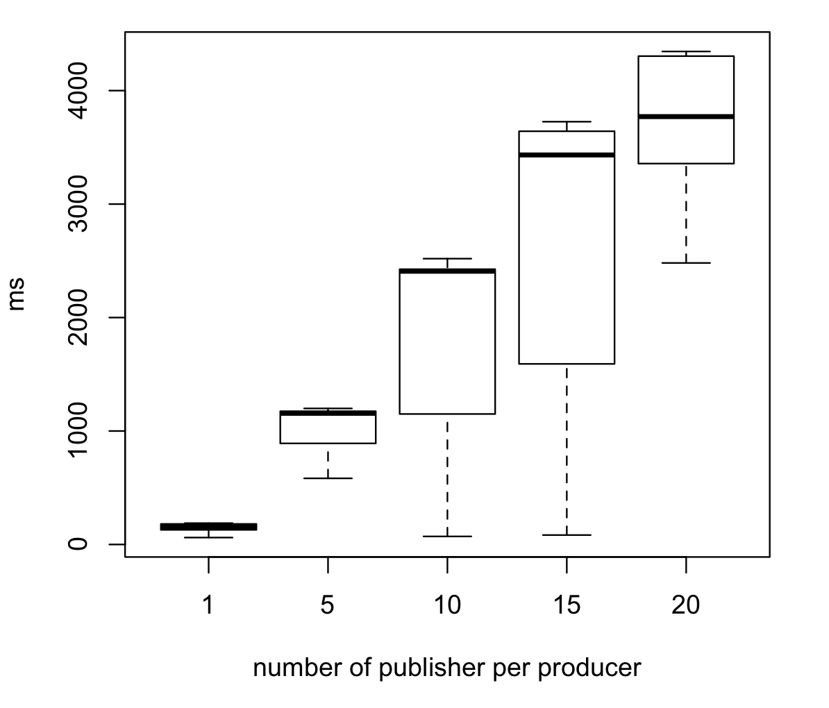
NSQD latency performance evaluation
The more publisher, the larger the the latency. Each publisher publish 1 topic and 3000 messages.
The performance is the same as our expectation of the larger message size needs longer processing time.

Slide 12
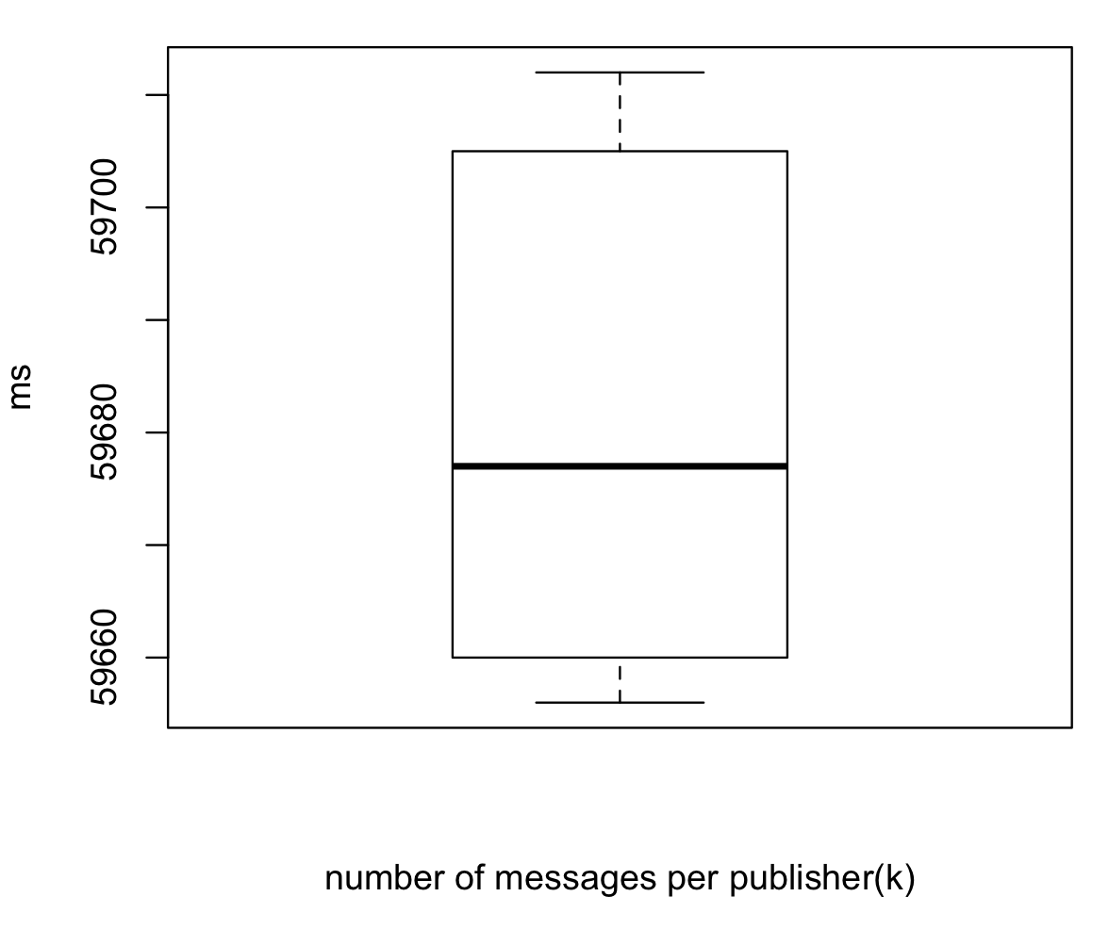
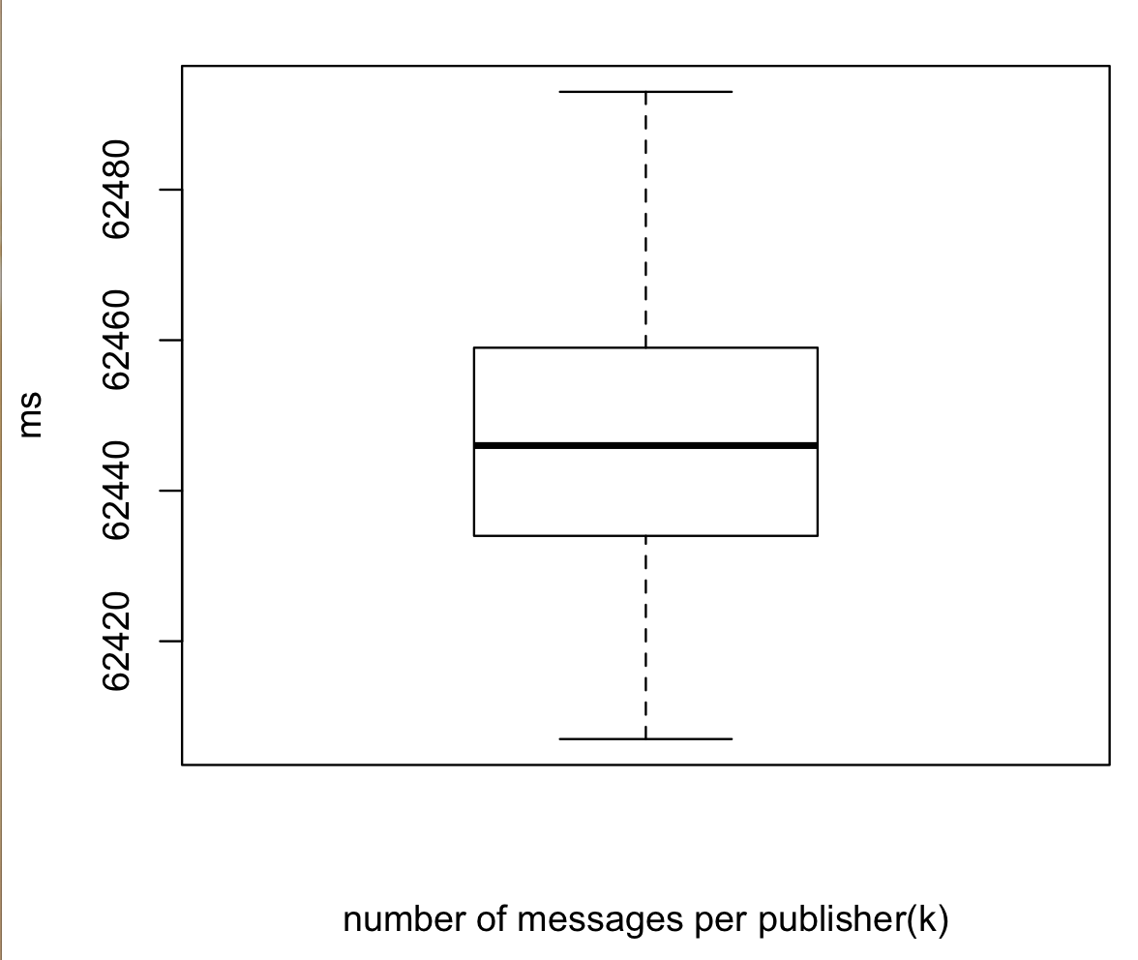
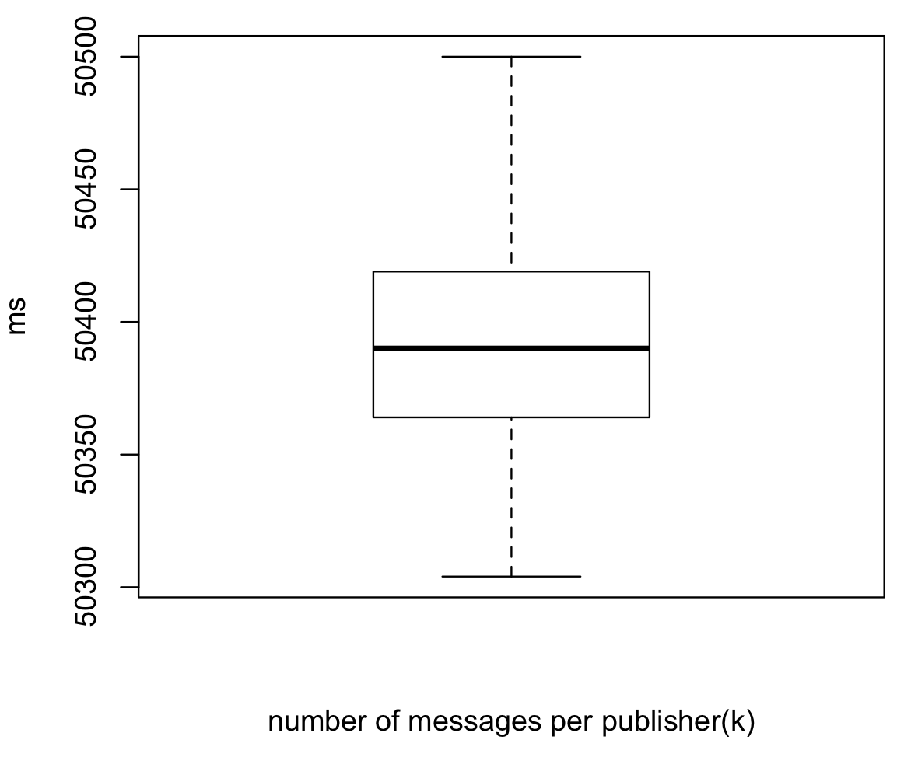
NSQD latency performance evaluation
lookupd has larger latency but the mean latency across different message size does not vary a lot.

Slide 13
NSQD latency performance evaluation
When using nsqlookupd, the average latency increase to 57000 ms per message.
The remote daemon’s low latency and high accuracy in delivery of message because of the server and nsq has a worse performance on local daemon.
Data not reported here because messages are lost in many cases and the benchmark experiment is not successful when deploying local daemon in raspberry pi’s.
The tool to measure latency: ptpd is relatively easy to deploy on ec2 based on the eth0 internet interface between ec2 servers.

Slide 14
NSQD latency performance evaluation
We need to tradeoff between latency that nsqlookupd brings and the higher scalability that nsqlookupd increases.
nsqlookupd becomes the bottleneck of the benchmark experiment since it needs to redirect the request to the specific nsqd and need to iterate through all the nsqd to look for the topic.
Flink needs to process each messages and generate a latency, we still need to parse each message into json and then send them out.

Slide 15
Review of the system performance and design
Latency:
as low as 10 seconds, not good enough for a stock trading system
Scalability:
in general is good and easy to deploy on any platform
workload and connections can be distributed through clusters
Reliability:
Reliable message delivery (every message are delivered )
Message are not stored on the nsqd and are destroyed by FIN command after delivery
Platform is independently deployed on different servers
PTPD deployment is quite easy after learning its working mechanism

Slide 16
Summary
Implement Apache Flink
Apply EMR Cluster, Measure Latency
NSQD performance evaluation (latency)
lookupd and nsqd comparison
Multiple Pulishers, Subscribers, different topic sizes
Connect Flink with NSQ
Latency is promising

Slide 17
Thanks

